Slide 1






2nd Project Progress Meeting 22 January 2024
Destination Renewable Energy (DRE) Use Case
Selected by RHEA under the ESA regulations and Best Practice processes

Slide 2
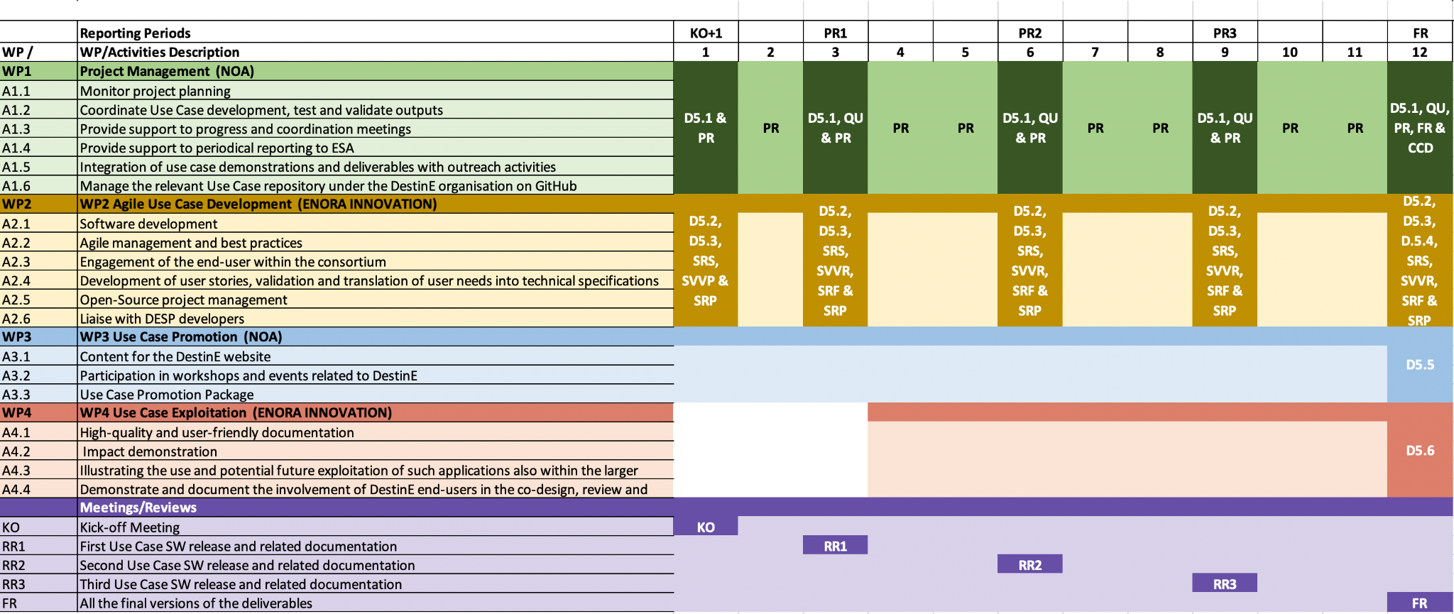
Gantt chart
13/11/2023
16/02/2024
17/05/2024
23/08/2024
20/11/2024
15/12
19/01
15/03
19/04
21/06
19/07
25/09
23/10
Notes:
Gantt chart has not changed, we just added the planned dates for the entire course of the project, on top based on today’s KO.

Slide 3
Status Overview
All actions assigned to the consortium at KO and KO+1 are completed
Internal weekly meetings in place
Sprint 2 is completed (further information under Sprint Review 2), including updates on SW design
KO+2 deliverables provided to RHEA Group
Abstracts submitted to IGARSS 2024 and EGU 2024:
IGARSS: Paper #1219: Destination Renewable Energy: A Renewable Energy application based on Destination Earth Initiative data and platforms (CCS.28: Copernicus and Destine Platform Ecosystem Opportunities)
EGU: The Development of a Hybrid Renewable Energy Forecasting System under the Destination Earth initiative (ESSI2.5, EDI, Digital Twins of the Earth System)

Slide 4
Sprint 2 Goal
(December 18th 2023 to January 19th 2024)
Software Workshop: Session took place on Thursday January 11th
Work is done or is in progress under below areas
Database Design
APIs initialization using sample data
UI login & template
Wireframes designed to cover the business need to contribute to the scalability of the use Case until DESP services are published
Data collection API and integration trials with Quest production sites
Integration trials with NOA for forecasting results
Provide access to DESP to the DRE team (intended after the meeting with the DESP team) → This Task was moved from previous Sprint as Open Item

Slide 5
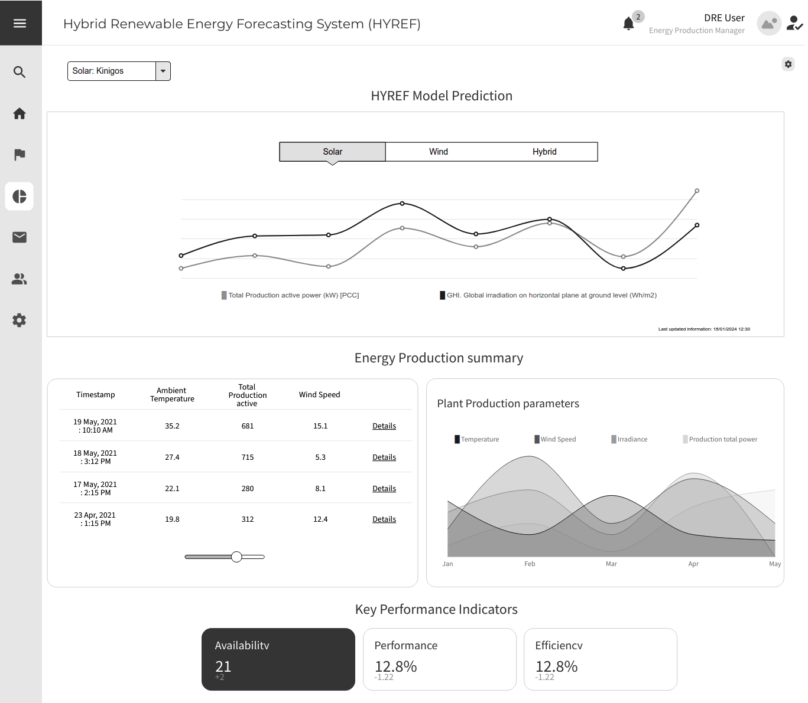
Wireframes - HYREF Model Prediction and Energy Production summary
HYREF model's predictive capabilities in forecasting energy production, along with a summary of actual energy output data for comparison and analysis

Slide 6
Thank you!

